Slide 1
Daemon Process Quiz
Jun Xu
CS-392 Systems Programming
Spring 2019

Slide 2

How To Create A Daemon
Call fork and have the parent exit
init becomes the process’ parent
The child is not a process group (PG) leader
Call umask() to set file creation mask to a fixed value (for example, 0)
Create a new session, by calling setsid()
Becomes a session and PG leader
Process is disassociated from controlling terminal
Change current directory to “/” or some fixed directory for the service
Close unneeded file descriptors, such as 0, 1, 2

Slide 3
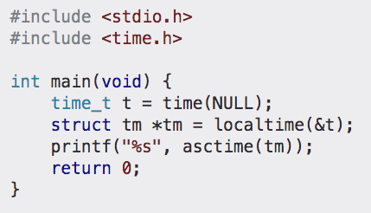
Quiz Specifics
Create a daemon process
It will use “/tmp” as the current working directory
It will need to close file descriptor 0, 1, 2
It will need to create a new file “cs392_daemon.log”
This daemon process keeps doing the following
Sleep 2 seconds
Write the current time as a new line into “cs392_daemon.log”
This is an example which gets the current time and print it as a string

